Slide 1
Exploring Semantic Reverse Engineering for Software Binary Protection
Pengfei Sun
Thesis advisor: Prof. Saman Zonouz
Committee Members: Prof. Ivan Marsic, Prof. Sheng Wei
and Dr. Praveen K. Murthy*
* Fujitsu Labs of America

Slide 2
Outline
Introduction
Trace-free memory data structure forensics
Reversing semantics of embedded IoT software binaries
Case-study: data attacks against power system operations
Known vulnerability detection for Mobile/IoT firmware
Conclusion

Slide 3
Outline
Introduction
Trace-free memory data structure forensics
Reversing semantics of embedded IoT software binaries
Case-study: data attacks against power system operations
Known vulnerability detection for Mobile/IoT firmware
Conclusion

Slide 4
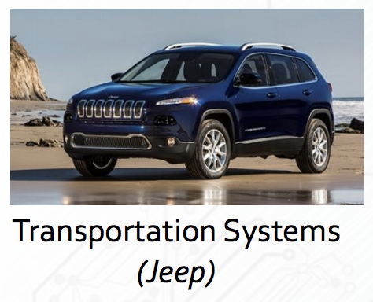


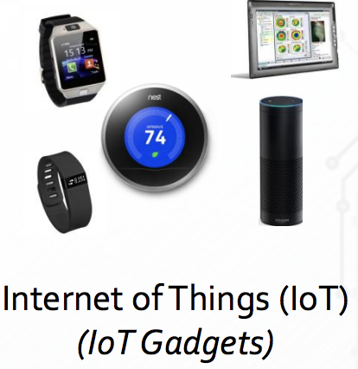

Software is Everywhere

Slide 5
Internet of Things (IoT) connected devices installed base worldwide from 2015 to 2025 (in billions)
Source: IHS ID 471264

Slide 6
Some Facts About Software
Society increasingly relies on software
… but it is unreliable and low quality
Maintenance is always essential
… but large amount embedded software is rarely updated
Bug

Slide 7
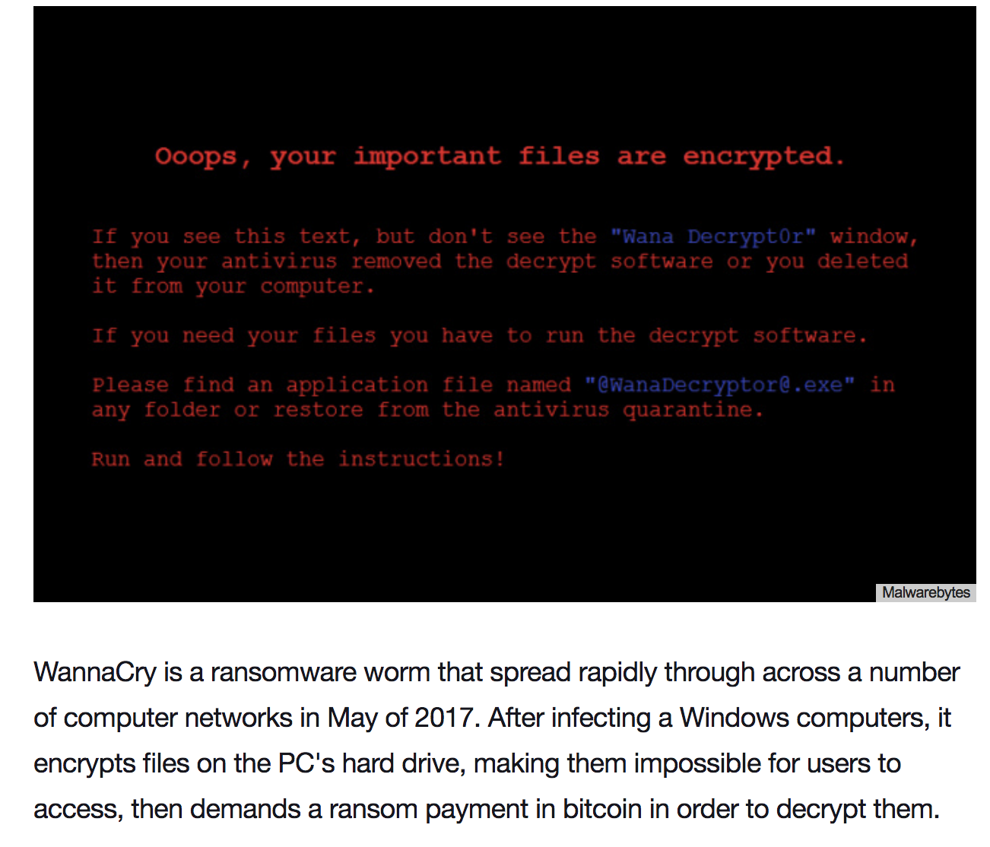
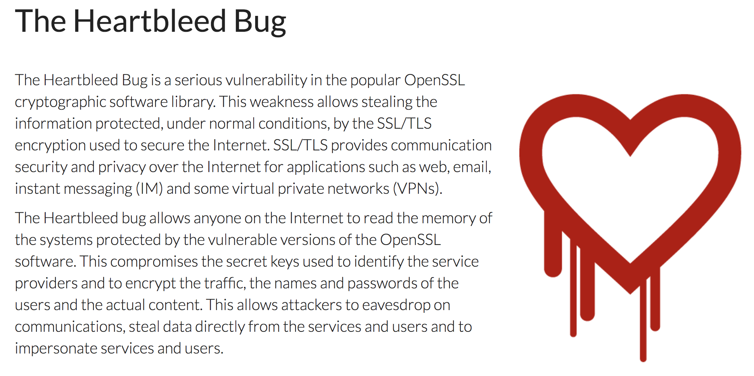

Slide 8

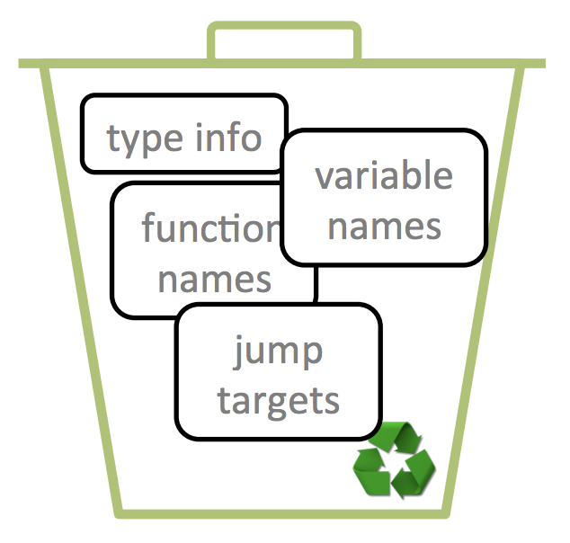
unsigned int foo(
char *buf,
unsigned int *out)
{
unsigned int c;
c = 0;
if (buf) {
*out = strlen(buf);
c = *out - 1;
}
return c;
}
Compile and Link
Strip

Slide 9
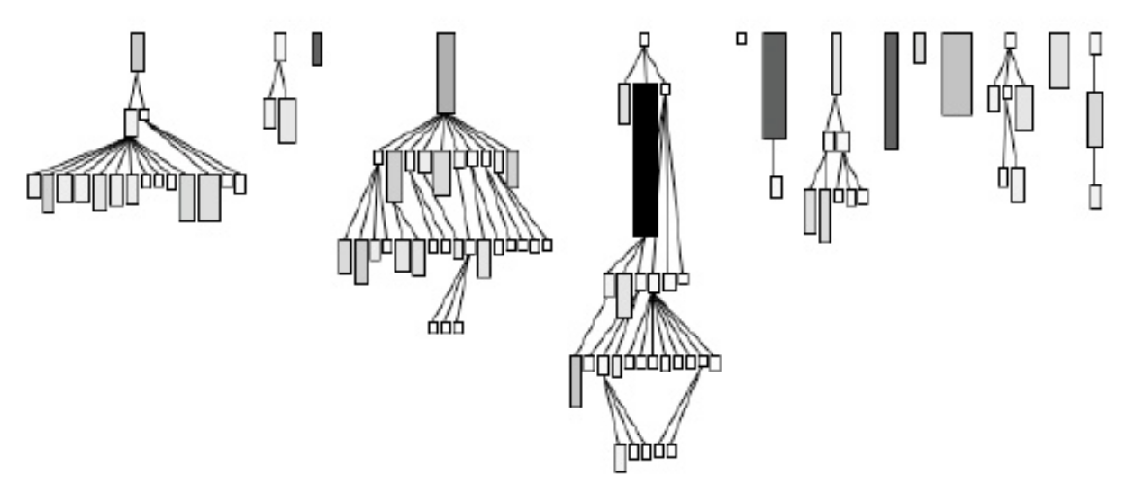
Software Reverse Engineering
Reverse Engineering
Assembly code
Control Flow Graph (CFG)

Slide 10
Semantic Reverse Engineering
Data Structure:
Definition
Memory instances
Semantic Reverse Engineering
Algorithm:
Control algorithm

Slide 11
Three Challenges
HOW TO recognize and recover data structure instances from a memory image without execution traces.
HOW TO locate the critical control algorithm implementation and extract the semantic meaning for the associated memory addresses/registers.
HOW TO leverage semantic reverse engineering for vulnerability detection.

Slide 12
Outline
Introduction
Trace-free memory data structure forensics
Reversing semantics of embedded IoT software binaries
Case-study: data attacks against power system operations
Known vulnerability detection for Mobile/IoT firmware
Conclusion
Pengfei Sun, Rui Han, Mingbo Zhang, Saman Zonouz, Trace-Free Memory Data Structure Forensics via Past Inference and Future Speculations. Annual Computer Security Applications Conference (ACSAC), 2016.

Slide 13
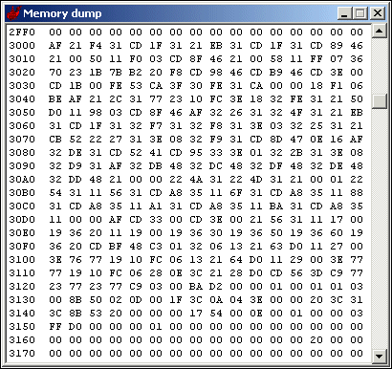
Motivation
Data structure 2
field type
field type
Memory forensics
Data structure 1
field type
Vulnerability
discovery
field type
Data structure 3
field type
field type
field type
field type
Malware
analysis

Slide 14
Previous Work
Limitations
My approach
Laika (OSDI’08)
Aggregated structure pattern
Correct data structure
SigGraph (NDSS’11)
Only kernel,
Source code
Stripped binary code
Reward (NDSS’10)
TIE (NDSS’11)
Howard (NDSS’11)
Need execution trace,
High overhead
No execution trace,
Low overhead

Slide 15

ReViver
service_library {
const char *
void *
struct service_library *
}
...
09406ca0 0000 0000 0021 0000 6004 0940 6d00 0940
09406cb0 0000 0000 efef efef fefe fefe 0018 0000
...
09407570 acfc b76f 0e7f af6f efef efef fefe fefe
09407580 0014 0000 0039 0000 0000 0000 0004 0000
...
known_function {
const char *
void *
}
Part of memory dump

Slide 16
ReViver
Present: static memory analysis
Past: statistical information
Future: speculative forensics

Slide 17
Present: Static Memory Analysis
...
09406ca0 0000 0000 0021 0000 6004 0940 6d00 0940
09406cb0 0000 0000 efef efef fefe fefe 0018 0000
...
09407570 acfc b76f 0e7f af6f efef efef fefe fefe
09407580 0014 0000 0039 0000 0000 0000 0004 0000
...
Memory initial layout
Suspension point
Part of memory dump

Slide 18
Present: Static Memory Analysis
Pointer address: 0x09406ca8
Trace-free reverse engineering
No need for execution tracing
Memory allocation function hooking (1.8% runtime overhead)
Landmarks (efef efef fefe fefe )
Superset of possible types for each memory region
String, pointer-to-pointers, data structure, str-zeros
...
09406ca0 0000 0000 0021 0000 6004 0940 6d00 0940
09406cb0 0000 0000 efef efef fefe fefe 0018 0000
...
09407570 acfc b76f 0e7f af6f efef efef fefe fefe
09407580 0014 0000 0039 0000 0000 0000 0004 0000
...
Part of memory dump
Landmarks
Size is 0x18
stru_0x9406ca8 {
pointer-str
pointer-stru
zero
}

Slide 19
Past: Statistical Information
Entry
Collecting statistical information
Completed symbolic execution
Best-effort partial symbolic execution
Relevant execution paths
Partial and directed
Suspend

Slide 20
Future: Speculative Forensics
...
09406ca0 0000 0000 0021 0000 6004 0940 6d00 0940
09406cb0 0000 0000 efef efef fefe fefe 0018 0000
Suspend
Backward taint analysis
Exit
Type sink
(e.g., library/ system calls and floating point instructions)

Slide 21
Case Study: CoreUtils Groups
...
09406ca0 0000 0000 0021 0000 6004 0940 6d00 0940
09406cb0 0000 0000 efef efef fefe fefe 0018 0000
...
09407570 acfc b76f 0e7f af6f efef efef fefe fefe
09407580 0014 0000 0039 0000 0000 0000 0004 0000
09407590 0018 0000 001b 0000 001e 0000 002e 0000
094075a0 006d 0000 007c 0000 03e8 0000 efef efef
094075b0 fefe fefe 0030 0000 0000 0000 ea49 0001
094075c0 0000 0000 0000 0000 0000 0000 0000 0000
094075d0 0000 0000 0000 0000 0000 0000 0000 0000
094075e0 0000 0000 0000 0000 0000 0000 0000 0000
094075f0 0000 0000 a980 b76e ffff ffff 0041 0000
09407600 0000 0000 0000 0000 7658 0940 ffff ffff
09407610 ffff ffff 0000 0000 7664 0940 0000 0000
09407620 0000 0000 ffff ffff ffff ffff 0000 0000
09407630 0000 0000 0000 0000 0000 0000 0000 0000
09407640 0000 0000 0000 0000 0000 0000 0000 0000
09407650 0000 0000 9a20 b76e 0000 0000 ffff ffff
09407660 0000 0000 0000 0000 0000 0000 0000 0000
09407670 0000 0000 0000 0000 0000 0000 0000 0000
09407680 0000 0000 0000 0000 0000 0000 0000 0000
09407690 0000 0000 0000 0000 0000 0000 0000 0000
094076a0 0000 0000 0000 0000 0000 0000 0000 0000
094076b0 0000 0000 0000 0000 0000 0000 0000 0000
094076c0 0000 0000 0000 0000 0000 0000 0000 0000
094076d0 0000 0000 0000 0000 0000 0000 0000 0000
094076e0 0000 0000 98a0 b76e efef efef fefe fefe
This case study will show how ReViver use the hybrid solution to get memory data structure layout.

Slide 22
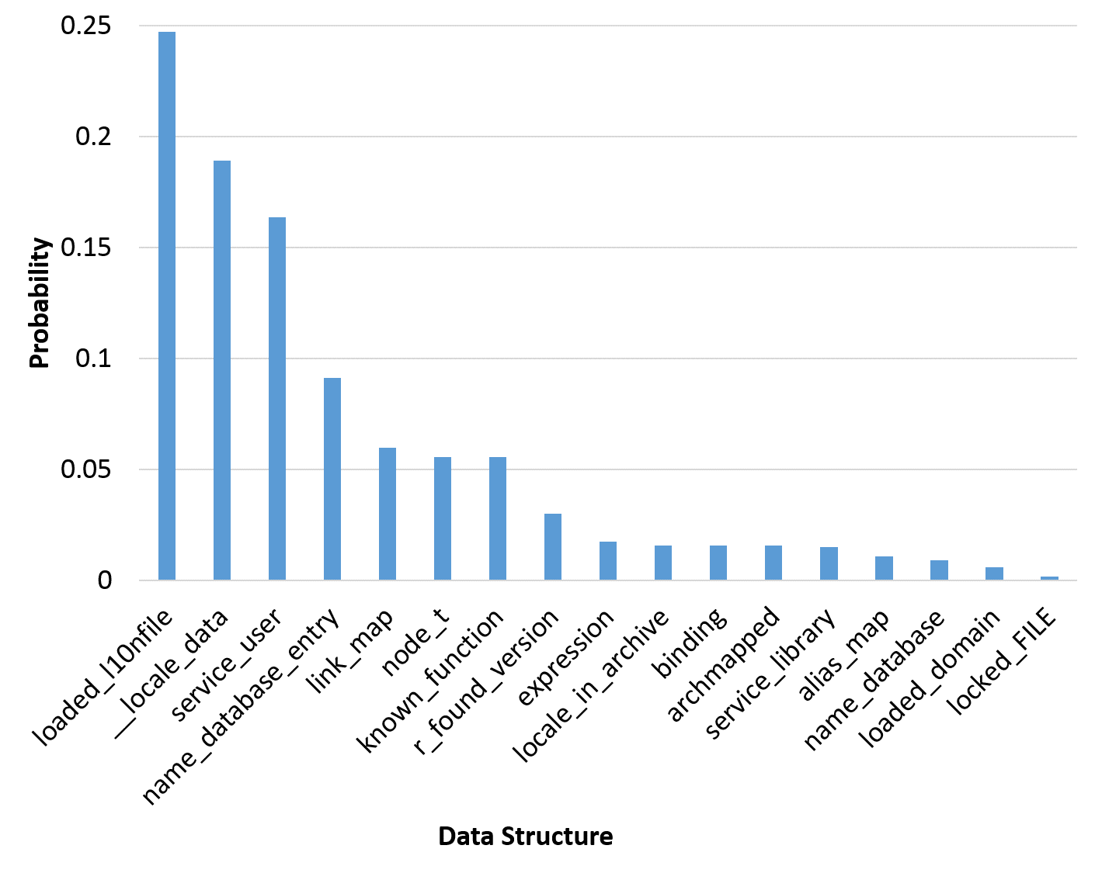
Case Study: CoreUtils Groups
...
09406ca0 0000 0000 0021 0000 6004 0940 6d00 0940
09406cb0 0000 0000 efef efef fefe fefe 0018 0000
...
service_library {
const char *
void *
struct service_library *
}
stru_0x9406CA8 {
pointer-str
pointer-stru
zero
}
Database
libname_list {
const char *
struct libname_list *
int
}

Slide 23
Case Study: CoreUtils Groups
...
09406ca0 0000 0000 0021 0000 6004 0940 6d00 0940
09406cb0 0000 0000 efef efef fefe fefe 0018 0000
...
09407570 acfc b76f 0e7f af6f efef efef fefe fefe
09407580 0014 0000 0039 0000 0000 0000 0004 0000
09407590 0018 0000 001b 0000 001e 0000 002e 0000
094075a0 006d 0000 007c 0000 03e8 0000 efef efef
094075b0 fefe fefe 0030 0000 0000 0000 ea49 0001
094075c0 0000 0000 0000 0000 0000 0000 0000 0000
094075d0 0000 0000 0000 0000 0000 0000 0000 0000
094075e0 0000 0000 0000 0000 0000 0000 0000 0000
094075f0 0000 0000 a980 b76e ffff ffff 0041 0000
09407600 0000 0000 0000 0000 7658 0940 ffff ffff
09407610 ffff ffff 0000 0000 7664 0940 0000 0000
09407620 0000 0000 ffff ffff ffff ffff 0000 0000
09407630 0000 0000 0000 0000 0000 0000 0000 0000
09407640 0000 0000 0000 0000 0000 0000 0000 0000
09407650 0000 0000 9a20 b76e 0000 0000 ffff ffff
09407660 0000 0000 0000 0000 0000 0000 0000 0000
09407670 0000 0000 0000 0000 0000 0000 0000 0000
09407680 0000 0000 0000 0000 0000 0000 0000 0000
09407690 0000 0000 0000 0000 0000 0000 0000 0000
094076a0 0000 0000 0000 0000 0000 0000 0000 0000
094076b0 0000 0000 0000 0000 0000 0000 0000 0000
094076c0 0000 0000 0000 0000 0000 0000 0000 0000
094076d0 0000 0000 0000 0000 0000 0000 0000 0000
094076e0 0000 0000 98a0 b76e efef efef fefe fefe
exit: malloc
ret: 0x094075c0
enter: fgetpos(0x094075c0, 0xbfdcbbb4)
definition: fgetpos(_IO_FILE *, fpost_t *)
_IO_FILE

Slide 24
Case Study: CoreUtils Groups
...
09406ca0 0000 0000 0021 0000 6004 0940 6d00 0940
09406cb0 0000 0000 efef efef fefe fefe 0018 0000
...
09407570 acfc b76f 0e7f af6f efef efef fefe fefe
09407580 0014 0000 0039 0000 0000 0000 0004 0000
09407590 0018 0000 001b 0000 001e 0000 002e 0000
094075a0 006d 0000 007c 0000 03e8 0000 efef efef
094075b0 fefe fefe 0030 0000 0000 0000 ea49 0001
094075c0 0000 0000 0000 0000 0000 0000 0000 0000
094075d0 0000 0000 0000 0000 0000 0000 0000 0000
094075e0 0000 0000 0000 0000 0000 0000 0000 0000
094075f0 0000 0000 a980 b76e ffff ffff 0041 0000
09407600 0000 0000 0000 0000 7658 0940 ffff ffff
09407610 ffff ffff 0000 0000 7664 0940 0000 0000
09407620 0000 0000 ffff ffff ffff ffff 0000 0000
09407630 0000 0000 0000 0000 0000 0000 0000 0000
09407640 0000 0000 0000 0000 0000 0000 0000 0000
09407650 0000 0000 9a20 b76e 0000 0000 ffff ffff
09407660 0000 0000 0000 0000 0000 0000 0000 0000
09407670 0000 0000 0000 0000 0000 0000 0000 0000
09407680 0000 0000 0000 0000 0000 0000 0000 0000
09407690 0000 0000 0000 0000 0000 0000 0000 0000
094076a0 0000 0000 0000 0000 0000 0000 0000 0000
094076b0 0000 0000 0000 0000 0000 0000 0000 0000
094076c0 0000 0000 0000 0000 0000 0000 0000 0000
094076d0 0000 0000 0000 0000 0000 0000 0000 0000
094076e0 0000 0000 98a0 b76e efef efef fefe fefe
Name | Size
0x94075C0 | 0x160
_IO_FILE | 0x94
locked_FILE | 0x160

Slide 25
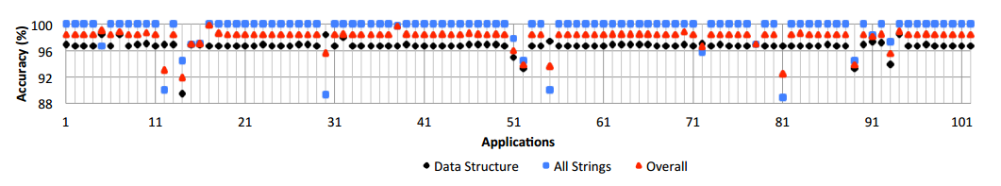
Accuracy
Accuracy: how many data structure instances have been recognized and recovered from memory image?
ReViver’s overall accuracy is 98.1%

Slide 26
Three Challenges
HOW TO recognize and recover data structure instances from a memory image without execution traces.
HOW TO locate the critical control algorithm implementation and extract the semantic meaning for the associated memory addresses/registers.
HOW TO leverage semantic reverse engineering for vulnerability detection.

Slide 27
Outline
Introduction
Trace-free memory data structure forensics
Reversing semantics of embedded IoT software binaries
Case-study: data attacks against power system operations
Known vulnerability detection for Mobile/IoT firmware
Conclusion
Pengfei Sun, Luis Garcia and Saman Zonouz, Tell Me More Than Just Assembly! Reversing Semantics of Embedded IoT and Industrial Control Software Binaries. The 49th IEEE/IFIP International Conference on Dependable Systems and Networks (DSN 2019), 2019.

Slide 28
Control Algorithm
Proportional-Integral-Derivate (PID) controllers are used in programmable logic controller (PLC) programs
Kalman-Filters for guidance, navigation and control of drones
Pulse-width modulation (PWM) is used for robotics and 3D printer extruder motor control

Slide 29
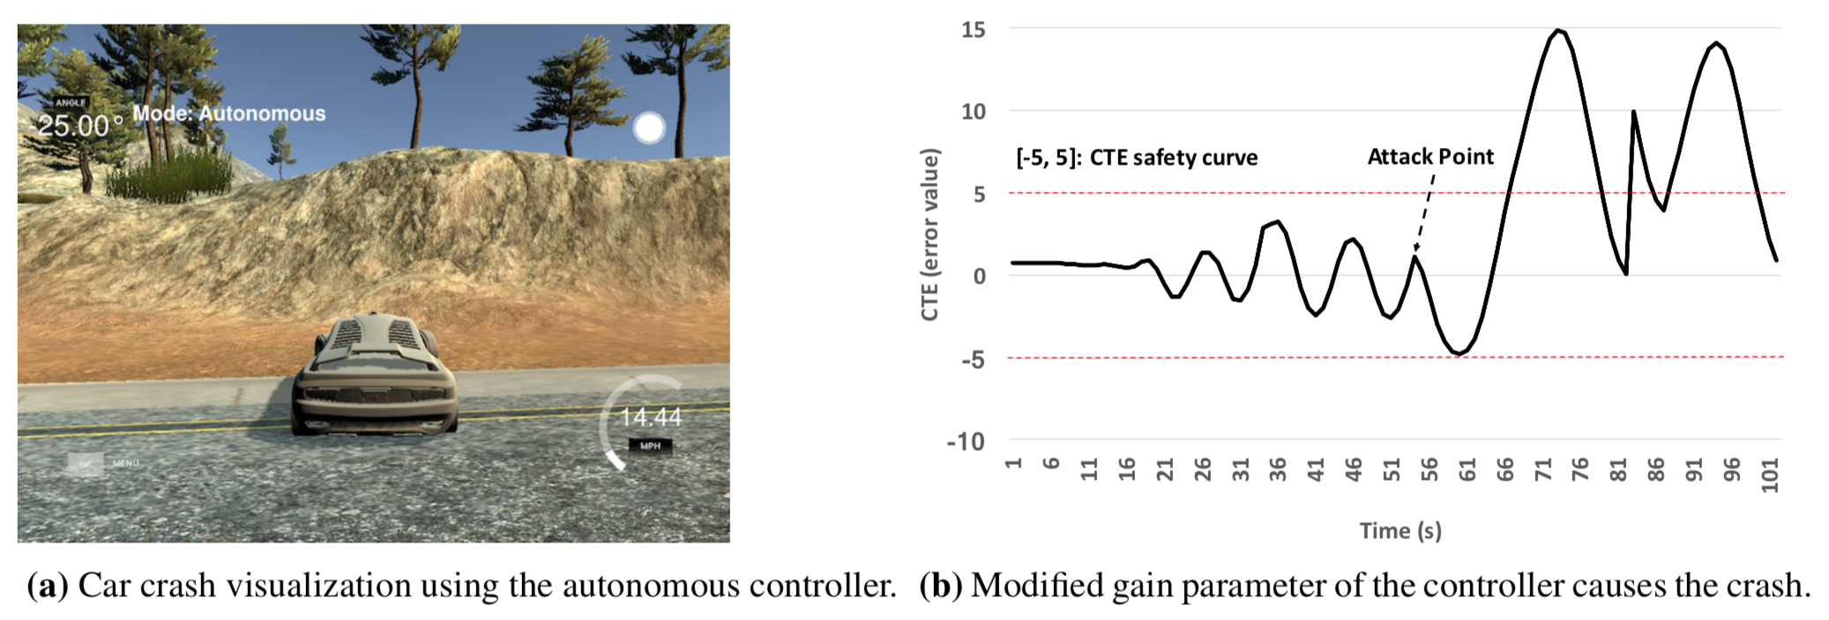
Motivation Example

Slide 30
Current Solutions
IDA PRO
OllyDbg
Ninja
Snowman
Disassembler,
Decompiler,
Static and dynamic analysis
Reward (NDSS’10)
TIE (NDSS’11)
Howard (NDSS’11)
ReViver (ACSAC’16)
Data structure definition,
Data structure memory instance
BinDiff (SSTIC'05)
BinJuice (PPREW '13)
Blex (Usenix’14)
Binary similarity checking

Slide 31
My Solution
Propose a domain-specific reverse engineering solution to extract high-level algorithmic control- and data-flow semantics from embedded binary executables in IoT and ICS applications.
Introduce a semantic mapping using dynamic binary analysis and symbolic comparison of the mathematical and binary expressions to fill the semantic gap between high-level algorithm descriptions and low-level stripped binary segments.

Slide 32
Mismo Overview
Control Algorithm’s Subroutine Identification
Binary executable
ICS/IoT Device
Controller Code
(binary executable)
Symbolic Controller
Abstract Syntax Trees
CFG Refinement
ICS/IoT
Control Algorithms
Algorithm
Algorithmic Mathematical
Abstract Syntax Trees

Slide 33

Mismo Overview
Symbolic Controller
Abstract Syntax Trees
Formal Symbolic
Equivalence Check
Annotated
Disassembly
Algorithmic Mathematical
Abstract Syntax Trees

Slide 34
Mismo Overview
Control Algorithm’s Subroutine Identification
ICS/IoT Device
Controller Code
(binary executable)
Symbolic Controller
Abstract Syntax Trees
CFG Refinement
ICS/IoT
Control Algorithms
Algorithmic Mathematical
Abstract Syntax Trees
Formal Symbolic
Equivalence Check

Slide 35
Case Study
Control Algorithm’s Subroutine Identification
Taint analysis
Arithmetic operations
ICS/IoT Device
Controller Code
(binary executable)
Symbolic Controller
Abstract Syntax Trees
CFG Refinement
ICS/IoT
Control Algorithms
Algorithmic Mathematical
Abstract Syntax Trees
Formal Symbolic
Equivalence Check

Slide 36
Case Study
Control Algorithm’s Subroutine Identification
ICS/IoT Device
Controller Code
(binary executable)
Symbolic Controller
Abstract Syntax Trees
CFG Refinement
Errors checking,
Value range checking
ICS/IoT
Control Algorithms
Algorithmic Mathematical
Abstract Syntax Trees
Formal Symbolic
Equivalence Check
36

Slide 37
Case Study
Control Algorithm’s Subroutine Identification
ICS/IoT Device
Controller Code
(binary executable)
Symbolic Controller
Abstract Syntax Trees
CFG Refinement
ICS/IoT
Control Algorithms
Algorithmic Mathematical
Abstract Syntax Trees
Formal Symbolic
Equivalence Check

Slide 38
Case Study
Symbolic expression
…
0x90DE: VMUL.F64 D6, D6, D7
-> 0xc0175999f54482ee
0x90E2: VLDR D7, [R7,#0x3C+var_2C]
-> 0x4028000000000000
0x90E6: VADD.F64 D7, D6, D7
-> 0x4018a6660abb7d12
…
Symbolic
output
variable
Backward value analysis
Symbolic execution
Symbolic Controller
Abstract Syntax Trees
Symbolic
input
variables
Backward slicing analysis

Slide 39
Case Study
Symbolic expression
((((Sym_15 ∗ (((Sym_12 ∗ Sym_11) ∗ Sym_13) + Sym_14)) / ((Sym_19 ∗ (Sym_15 ∗ (((Sym_12 ∗ Sym_11) ∗ Sym_13) + Sym_14))) + Sym_16)) ∗ ((((Sym_7) ^ (-1) ∗ Sym_8) + ((Sym_5 ∗ (((Sym_3) ^ (-1) ∗ Sym_4) + ((Sym_0 ∗ Sym_1) + (Sym_18 ∗ Sym_2)))) + (Sym_18 ∗ Sym_6))) − ((Sym_19 ∗ ((Sym_18 ∗ Sym_10) + (Sym_11∗ Sym_9))) + (Sym_17 ∗ Sym_18)))) + ((Sym_18 ∗ Sym_10) + (Sym_11 ∗ Sym_9)))
Symbolic Controller
Abstract Syntax Trees

Slide 40
Case Study
Symbolic Controller
Abstract Syntax Trees

Slide 41
Case Study
Algorithmic Mathematical
Abstract Syntax Trees

Slide 42
Mismo Overview
Sym_3 -> Q
Sym_7 -> R
…
Formal Symbolic
Equivalence Check

Slide 43
Annotated Disassembly

Slide 44
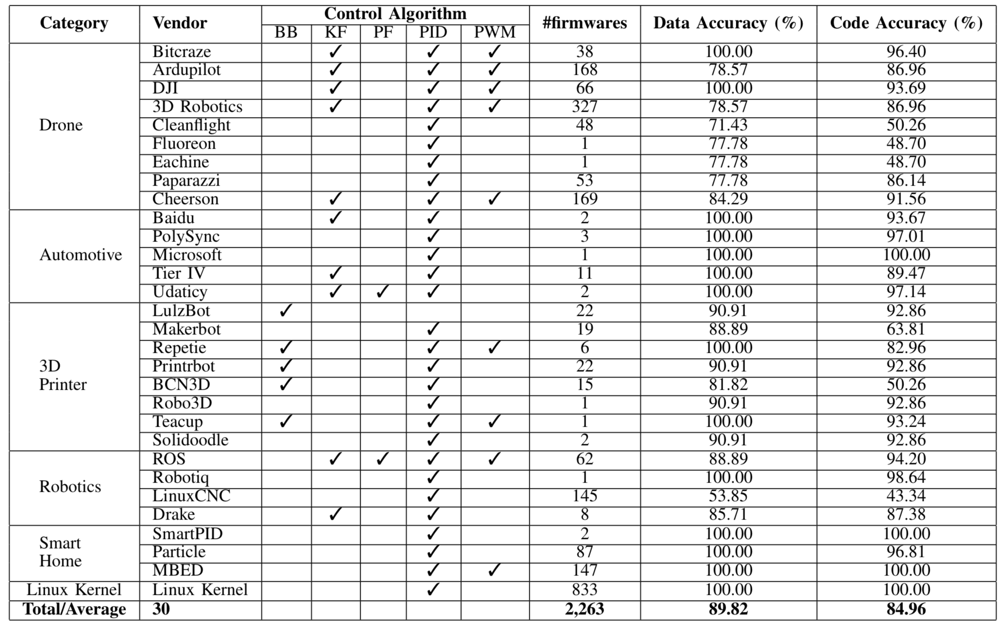
Evaluation
Data: the portion of resolved symbolic variables
Accuracy
Code: the portion of resolved instructions

Slide 45
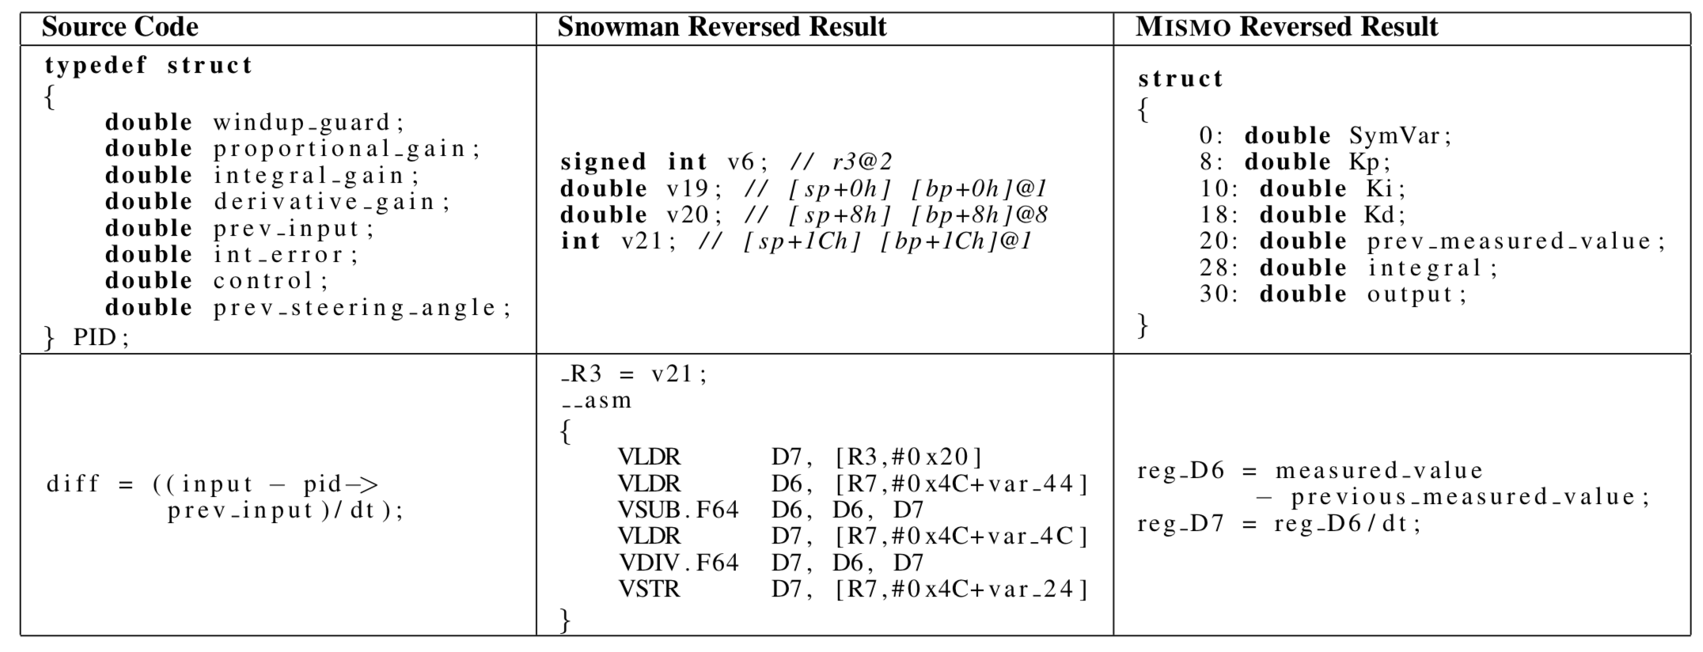
Compare with Snowman (decompiler)

Slide 46
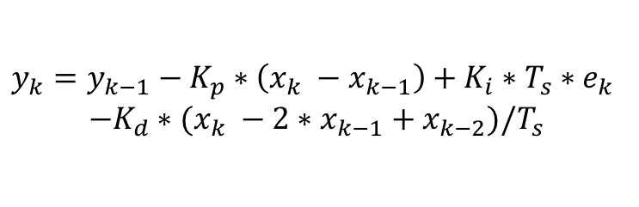
Linux Kernel Bug
$$y_{k}={y_{k−1}−K_{p}∗\left(x_{k} −x_{k−1}\right)+K_{i}∗T_{s}∗e}_{k}$$
$$−K_{d}∗(x_{k} −2∗x_{k−1}+x_{k−2})/T_{s}$$
Algorithm
Mismo
Program Code
…
/* compute intermediate PID terms */
p_term = -p_param.kp * (xk - xk_1);
i_term = p_param.kp * p_param.ki * p_param.ts * ek;
d_term = -p_param.kp * p_param.kd * (xk - 2 * xk_1
+xk_2) / p_param.ts;
/* compute output */
*yk += p_term + i_term + d_term;
…

Slide 47
Outline
Introduction
Trace-free memory data structure forensics
Reversing semantics of embedded IoT software binaries
Case-study: data attacks against power system operations
Known vulnerability detection for Mobile/IoT firmware
Conclusion
Devendra Shelar, Pengfei Sun, Saurabh Amin, Saman Zonouz, Compromising Security of Economic Dispatch in Power System Operations. The 47th IEEE/IFIP International Conference on Dependable Systems and Networks (DSN 2017), 2017.

Slide 48
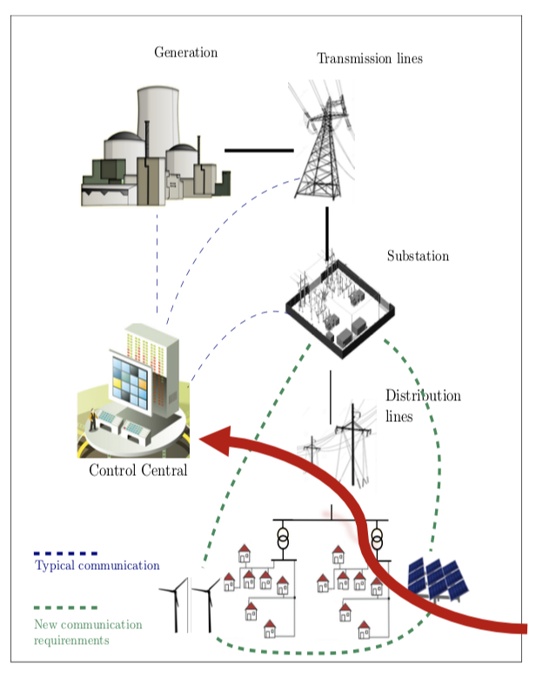

Attack Target
Control algorithm (e.g. Optimal Power Flow)

Slide 49


Physics-aware memory attack on control systems
Controller Software
control loop
memory control
data corruption
measurements
control commands
Cyber
Physical
…
…
Power System
sensors
actuators

Slide 50
My Approach
Offline controller software analysis and memory pattern extraction
Control-sensitive parameters (memory values) that can be detected and modified by the attack
Adversary-optimal value calculation for modifiable parameters
Malicious values for control-sensitive parameters
Runtime attack: control-sensitive data location and corruption

Slide 51
Logical memory structural patterns
Intra-class type patterns
Logical memory structural patterns
Code pointer-instruction patterns
Data pointer-based patterns

Slide 52
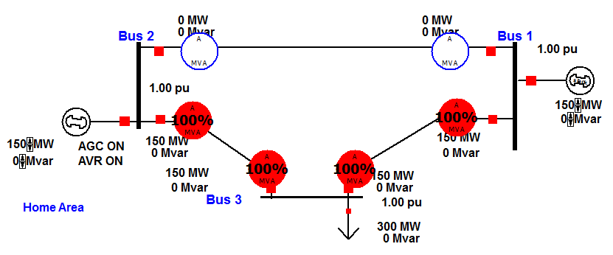
PowerWorld pre-attack system state
Transmission line
Bus
Generator
06410AE0 0001 0000 65C0 0949 0000 0000 0000 0000
06410AF0 0000 0000 0000 0000 0000 0000 FE00 0000
06410B00 0000 0000 0000 0000 0001 0000 0000 0000
06410B10 0000 0000 0000 3FC0 FAE1 42C7 FAE1 42C7
06410840 0001 0000 64A0 0949 0000 0000 0000 0000
06410850 0000 0000 0000 0000 0000 0000 FE00 0000
06410860 0000 0000 0000 0000 0001 0000 0000 0000
06410870 0000 0000 0000 3FC0 FAE1 42C7 FAE1 42C7

Slide 53
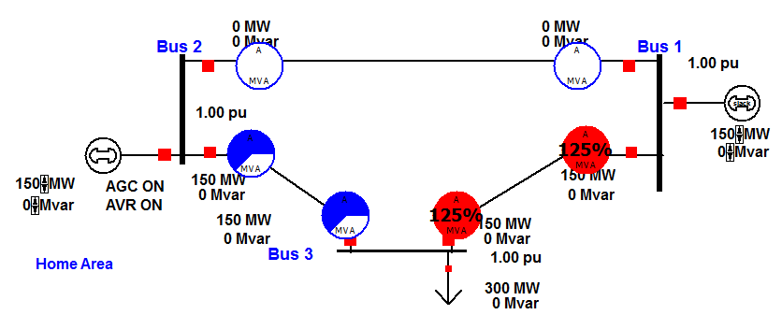
PowerWorld post-attack system state
06410AE0 0001 0000 65C0 0949 0000 0000 0000 0000
06410AF0 0000 0000 0000 0000 0000 0000 FE00 0000
06410B00 0000 0000 0000 0000 0001 0000 0000 0000
06410B10 0000 0000 999A 4019 FAE1 42C7 FAE1 42C7
06410840 0001 0000 64A0 0949 0000 0000 0000 0000
06410850 0000 0000 0000 0000 0000 0000 FE00 0000
06410860 0000 0000 0000 0000 0001 0000 0000 0000
06410870 0000 0000 999A 3F99 FAE1 42C7 FAE1 42C7

Slide 54
Three Challenges
HOW TO recognize and recover data structure instances from a memory image without execution traces.
HOW TO locate the critical control algorithm implementation and extract the semantic meaning for the associated memory addresses/registers.
HOW TO leverage semantic reverse engineering for vulnerability detection.

Slide 55
Outline
Introduction
Trace-free memory data structure forensics
Reversing semantics of embedded IoT software binaries
Case-study: data attacks against power system operations
Known vulnerability detection for Mobile/IoT firmware
Conclusion
Pengfei Sun, Luis Garcia, Saman Zonouz, I Know What You Didn't Do Last Vulnerability! Firmware Analysis via Deep Learning for Known Security Vulnerabilities. The 26th ACM Conference on Computer and Communications Security (CCS’19), 2019, to be submitted.

Slide 56
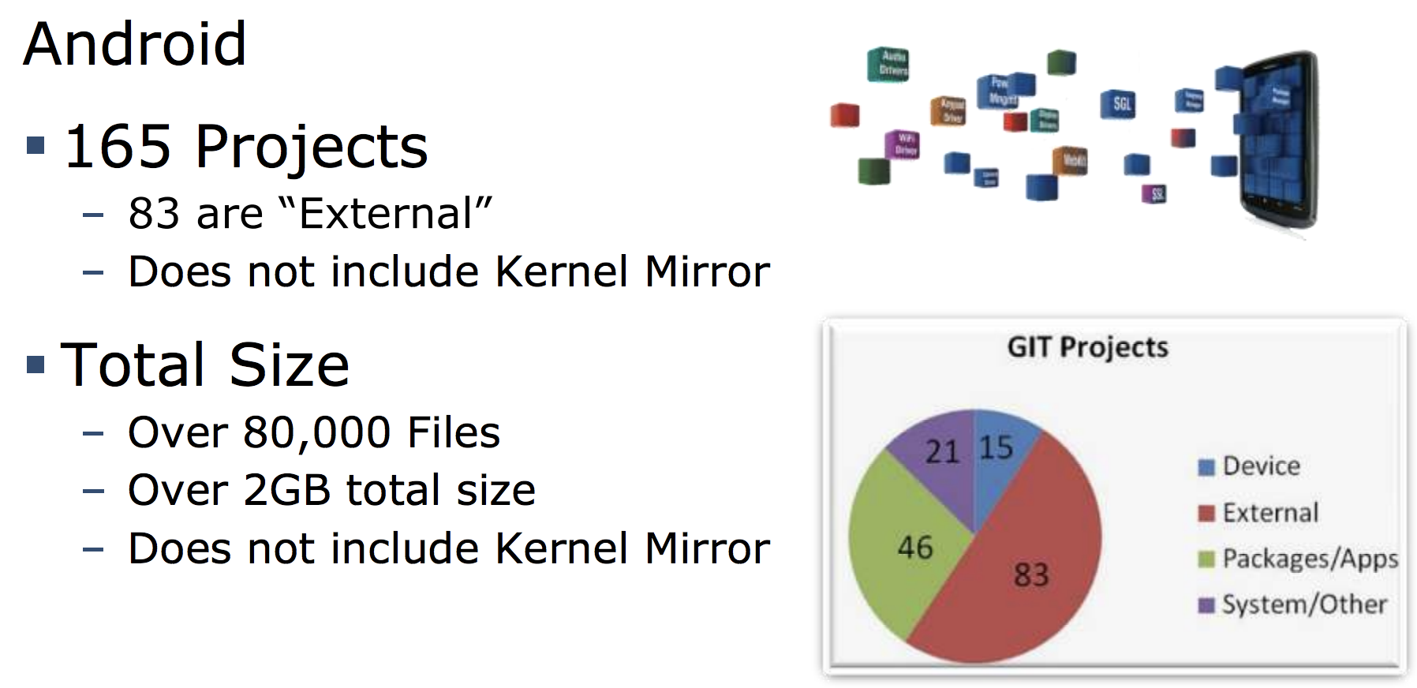

Slide 57

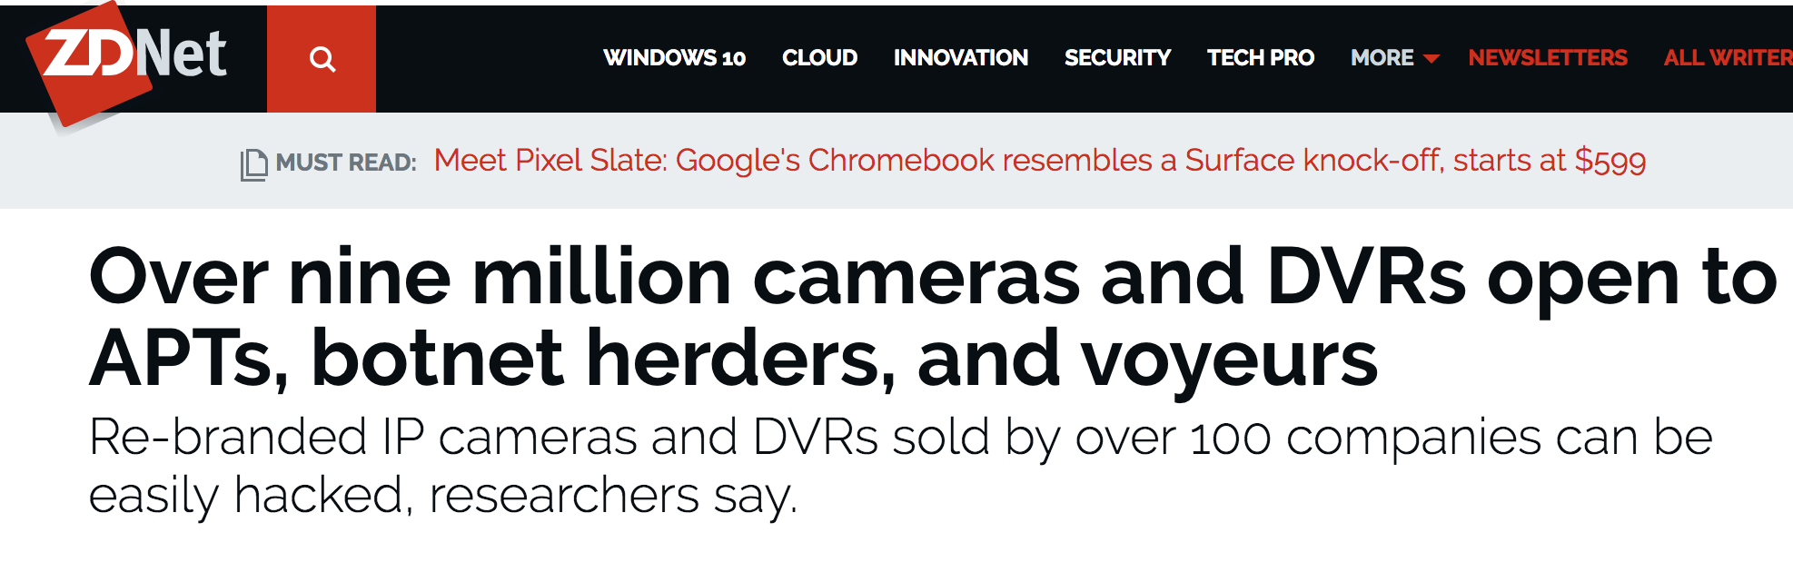

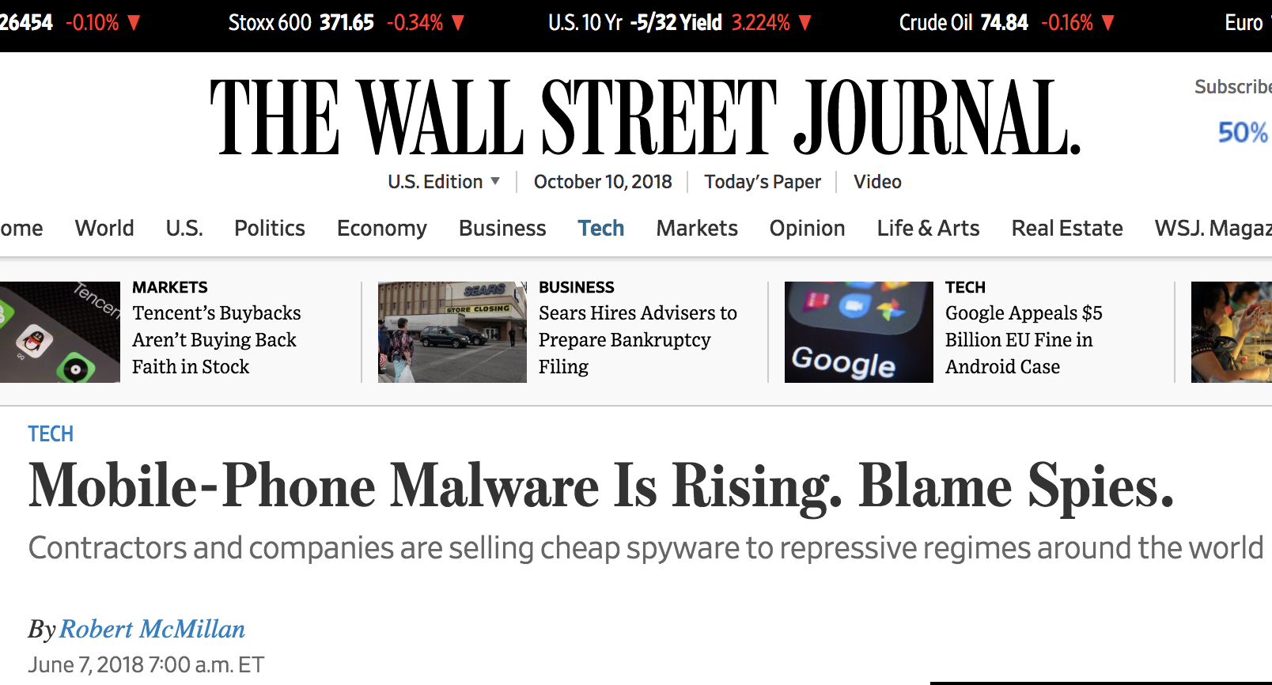
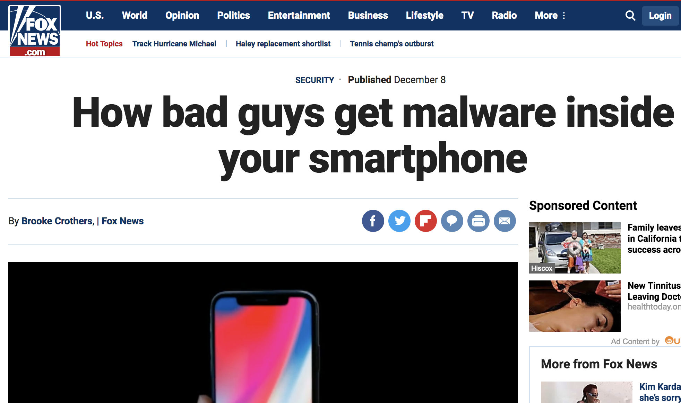

Slide 58
07/2016 so far
~ 2,076 REPORTED Vulnerabilities
only in Android

Slide 59
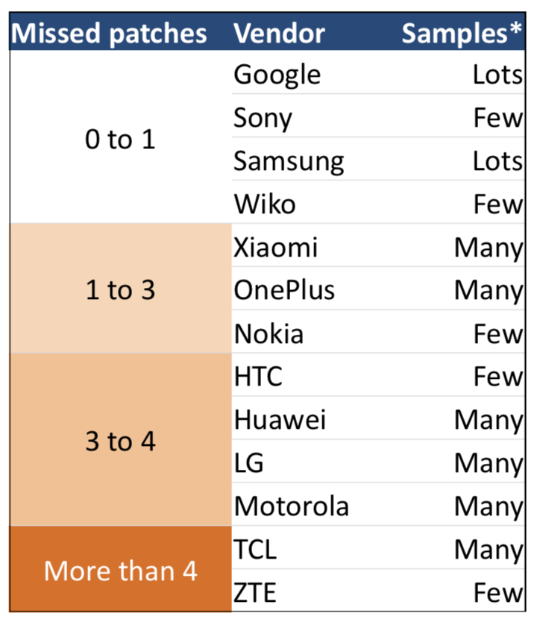
Hidden patch gap
Patches are handed down a long chain, e.g., four parties for Android user (OS vendor → Chipset vendor → Phone vendor → Carrier)
Only some devices get pathed, even these “full patched” are still missing some patches

Slide 60
Automate the known vulnerability detection in Mobile/IoT?

Slide 61
Objectives
Mobile/IoT
Firmware

Slide 62
Challenges for Vulnerability Detection
No source code available
No cooperation from device vendors
No cooperation from firmware developers
Cross-Platform
Automation &
Scalability
x86
Similar or not similar? It’s a problem!
ARM

Slide 63
Previous Work
Ccfinder (IEEE’02)
Deckard(IEEE’07)
Soure code
BinDiff (SSTIC'05)
BinJuice (PPREW '13)
Blex (Usenix’14)
Discovre (NDSS’16)
FIBER(Usenix’18)
Binary,
Only Static or dynamic analysis,
No cross-platform,
Overhead high,
Know the location of vulnerability
Genius(CCS’16)
Gemini(CCS’17)
Machine learning,
Large search space problem

Slide 64
BinSec
Automated vulnerability assessment of Mobile and IoT firmware
To detect known security vulnerabilities
Assumptions (threat model):
No source code access is available
No cooperation from the device vendors
Success measures
Accuracy: identify vulnerable/malicious code w/o false positives
Performance: reasonable analysis time for practical deployments
Usable: human-perceivable report generation about the discoveries

Slide 66
BinSec’s Architecture
1. Use A.I. and Machine Learning to Train the Vulnerability Detector
Vulnerable Code DB
(e.g., CVEs)
CFGs
Firmware Analysis and Feature Extraction
features
Deep Learning Neural Network Model Training
Preprocessing
(one-time)
2. Vulnerability Detector analyzes the target Mobile/IOT firmware
Target Mobile/IoT Firmware Image Binary
binary
Feature Vector Calculation for All the Functions
vectors
Classification (whether vulnerable?)
Firmware
Static Analysis
3. The identified vulnerable components are run for verification!
Dynamic
Analysis &
Reporting
On-Device | Emulator-Based Execution of Reported Vulnerabilities
traces
Dynamic Analysis of the Execution Traces
vectors
Trace-to-Trace Similarity Analysis to Discard False Positives
Reports: vulnerable code points, sample exploits

Slide 67
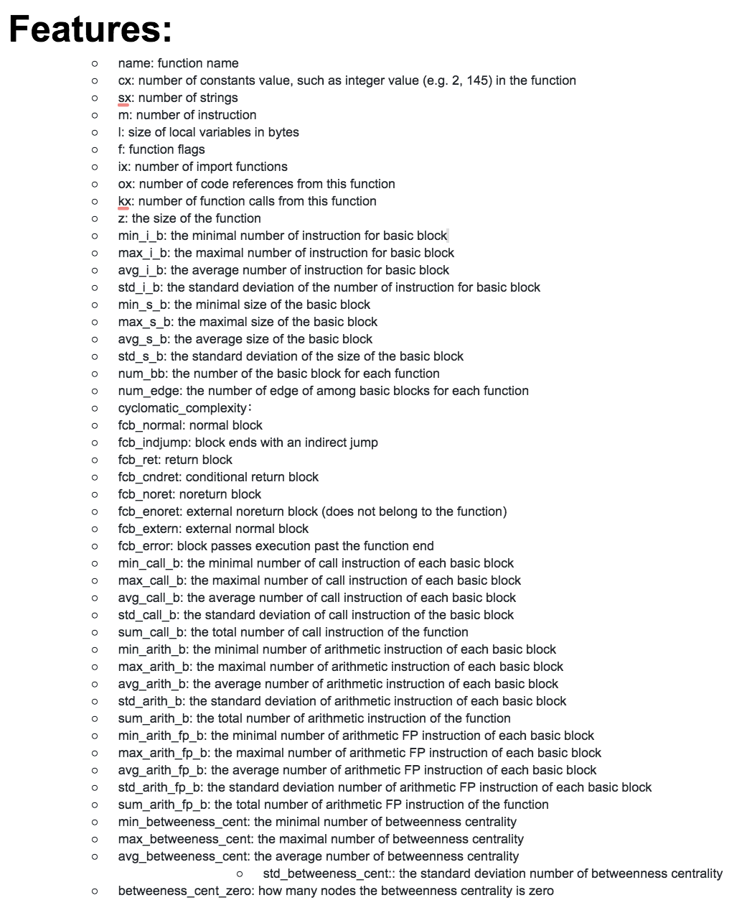
Binary Analysis
Subroutine Control Flow Graphs (of different ISAs, e.g., ARM, x86, etc.)
48-dimensional
feature vectors

Slide 68
Deep Learning (one-time effort)
Goal: identify whether the following function pair come from the same (very similar) source codes (a CVE function binary, a firmware function binary)
If so, the firmware function has the same vulnerability as the CVE function
Train a deep neural network to detect similar feature vectors
Two similar feature vectors correspond to the two subroutine (function) binaries that come from the same (very similar) source codes
Training data: function pairs and a bit indicating whether the two functions are similar (each data point has 2x48+1=97 dimensions)
(function-1 feature vector, function-2 feature vector, 0|1)
We generated >2,000,000 data samples for model training

Slide 69
Deep Learning - Training (one-time effort)
>2,000,000 samples
Training (approx. 1 day)
96% accuracy

Slide 70
How to locate vulnerable functions in a target Mobile/IoT firmware?

Slide 71
Static Analysis of the TARGET Firmware
48-dimensional
feature vectors
Firmware image
Control Flow Graphs

Slide 72
Static Analysis: Classification
379 similarities
(vulnerable functions)
reported in Android i.e., 378 false positives
Similar
Non-similar
CVE function
Firmware function
Classification (<2 seconds)

Slide 73
How to identify and get rid of the false positives?

Slide 74
Dynamic Analysis
Heavyweight analysis of the false positives, i.e., firmware functions reported as vulnerable by the static analysis
Via concrete execution and comparison of the CVE and firmware functions
On-Device execution
For Mobile/IoT devices where remote execution/debugging is feasible
Our experiments: Android (Google Pixel 2 phone) and AndroidThings (LG Smart Display)
Emulator-based execution
For closed IoT devices with limited/no dynamic access to its processor
Our experiments: for non-Pixel (closed) Android phones
Steps
Obtain the execution trace pairs of the false positives (subset of firmware functions and the corresponding CVE functions)
Measure similarity of the trace pairs → report correct matches

Slide 75
Dynamic Analysis (Challenges)
Execution
The whole binary execution
Function-level execution
How to do Function-level execution?
DLOPEN
Export all functions
Function inputs
Fuzzing
Instrumentation
GDB
IDA PRO

Slide 76
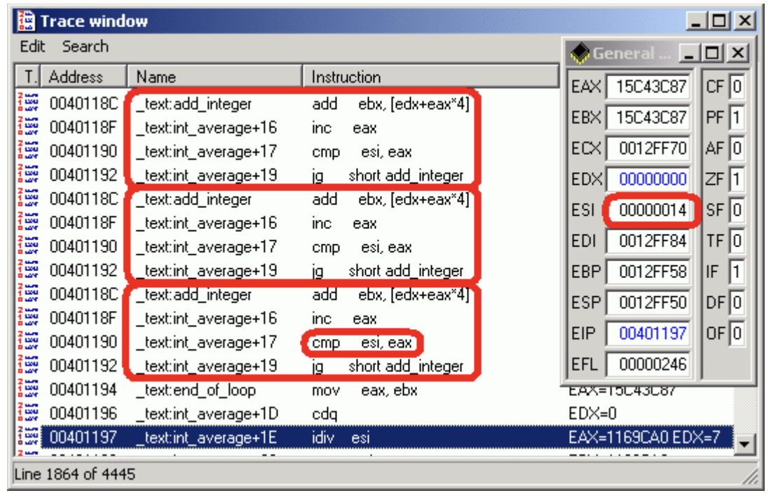
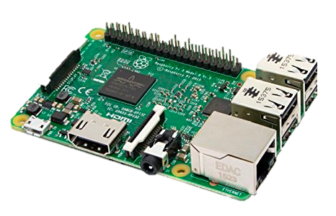
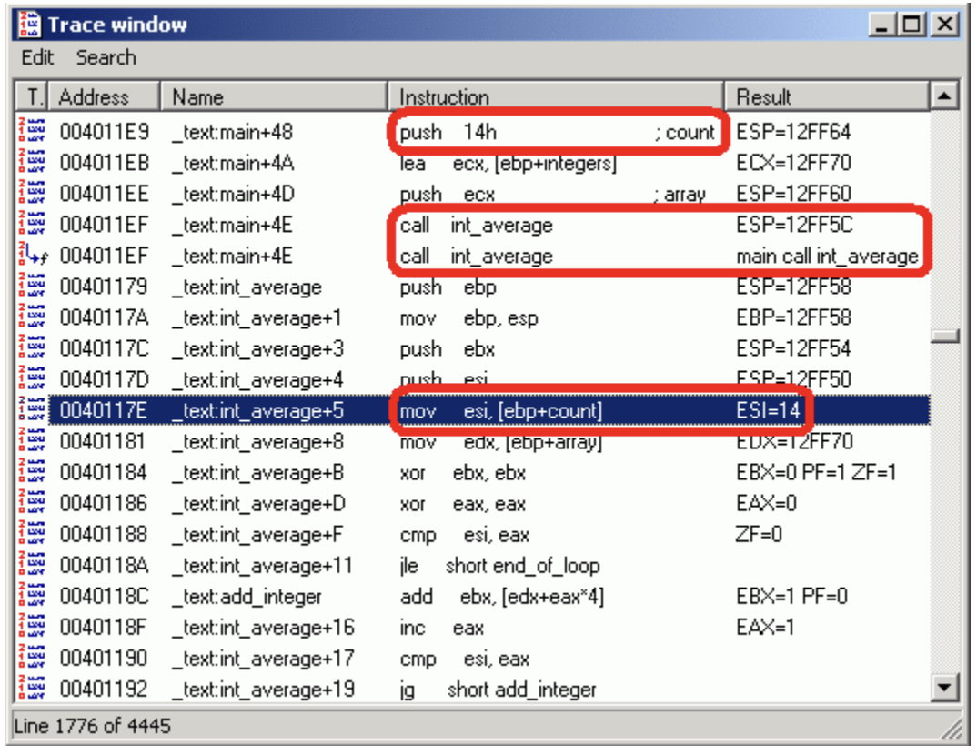
Dynamic Analysis
CVE function
On-Device or
Emulator-Based
Execution
Firmware function

Slide 77
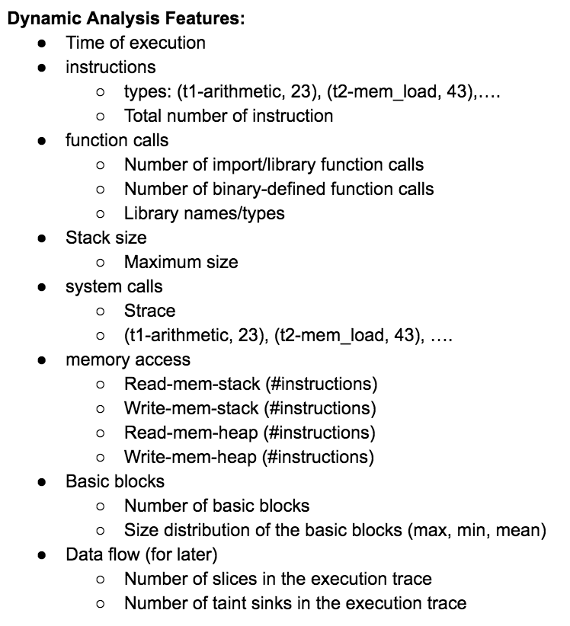
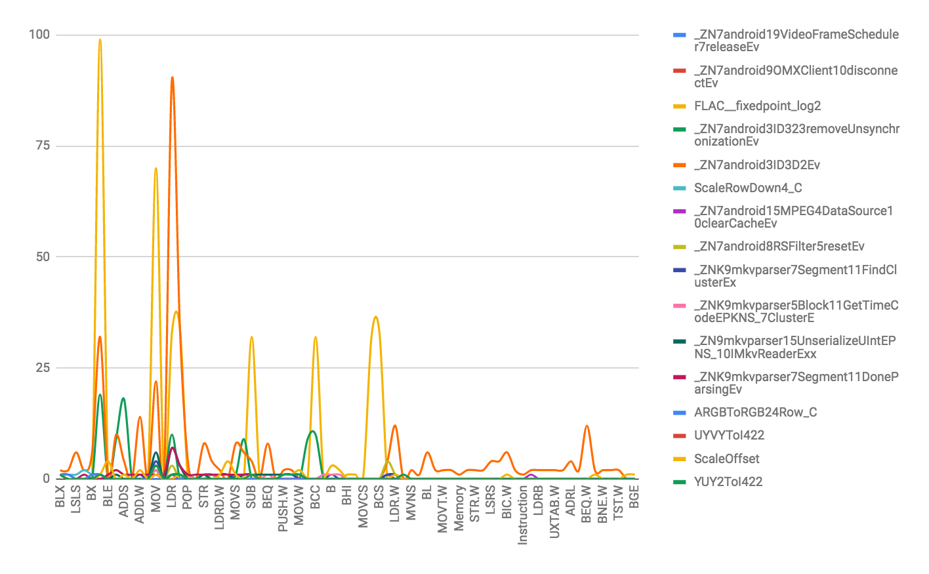
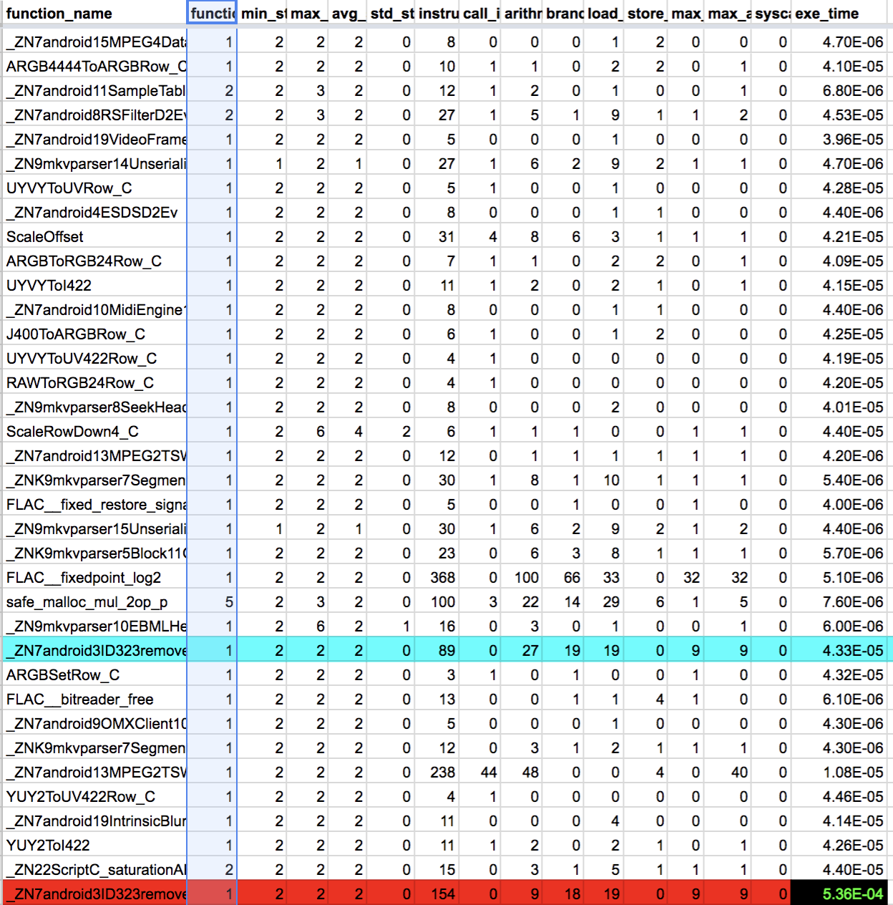
Dynamic Analysis
All false positives removed!
1 true positive identified.
CVE function trace
CVE trace features
Trace2Trace Mapping (similarity calculation)
Firmware function trace
Firmware trace features

Slide 78
Case Study
CVE-2018-9412 (Android)
This is a DoS vulnerability in the function removeUnsynchronization of the library libstagefright
Android Things 1.0 firmware
Training dataset:
100 Android libraries
x86, amd64, ARM 32bit and ARM 64bit
O0, O1, O2, O3, Oz, Ofast
2,108 binary files
Some results
5,646 functions
252 candidate functions
38 candidate functions

Slide 79
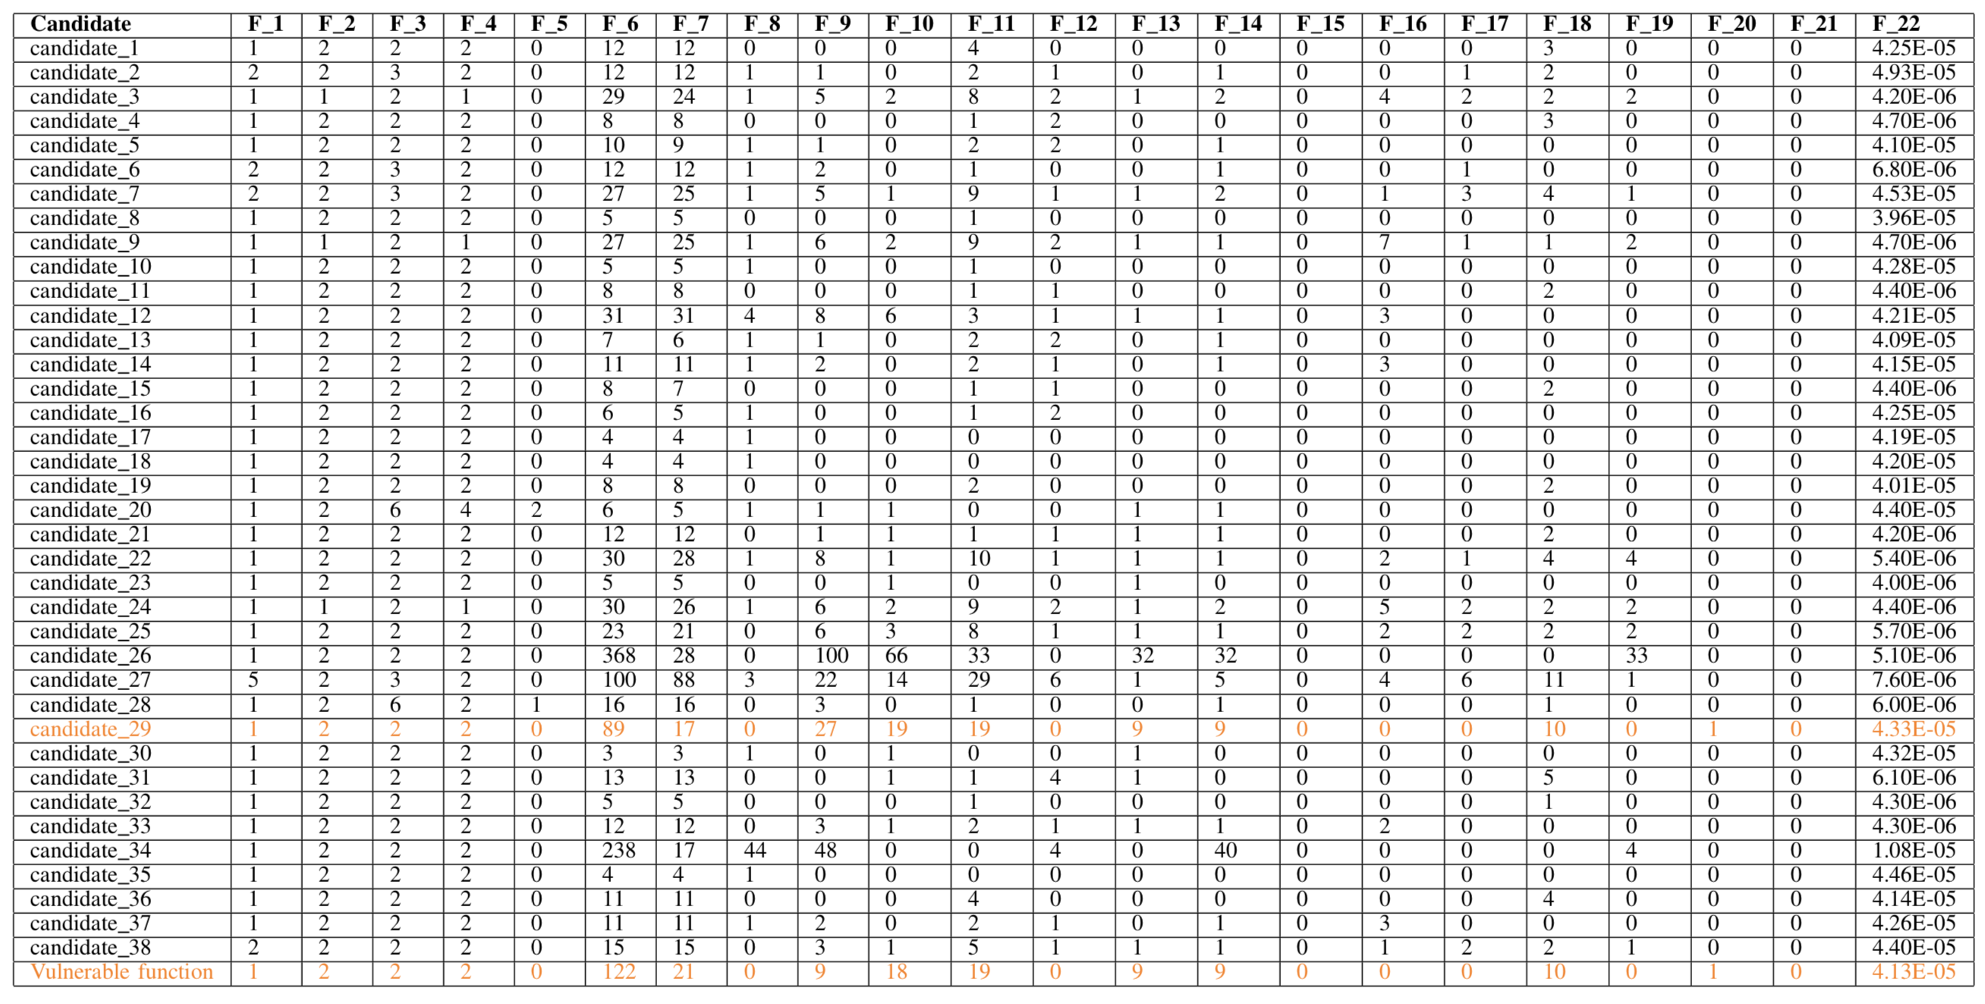
Dynamic Features Vector Profiling

Slide 80
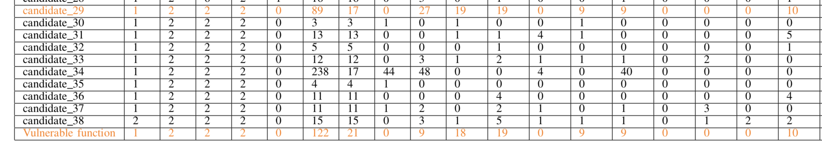
Dynamic Features Vector Profiling
F_13: max frequency for the same branch instruction
F_14:max frequency for the same arithmetic instruction

Slide 81
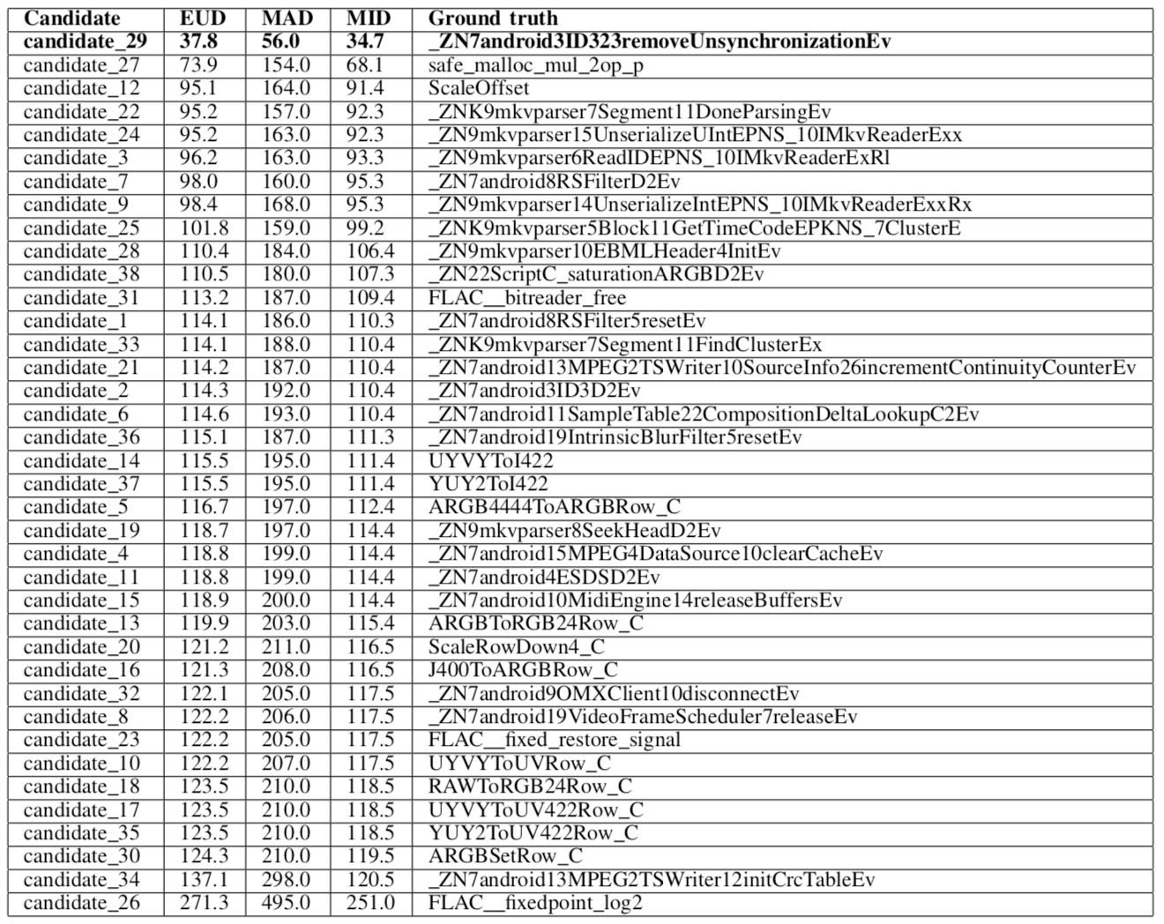
Calculating Function Similarity
Euclidean distance
Manhattan distance
Minkowski distance

Slide 82
Evaluation
Dataset I
100 Android libraries
2,108 binary files
2,037,772 function feature samples
Dataset II
2,076 vulnerabilities (from 07/2016)
1,351 high vulnerabilities and 381 critical vulnerabilities
Dataset III
Android Things 1.0 and Google Pixel 2 XL (Android 8.0)
25 different CVE vulnerabilities (Android 8.0 and 8.1)

Slide 83
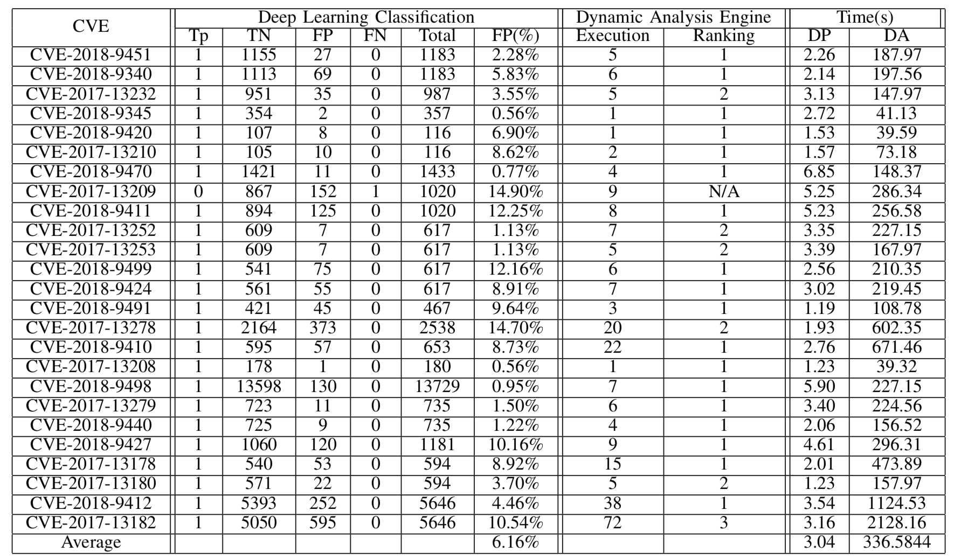

Slide 84
Outline
Introduction
Trace-free memory data structure forensics
Reversing semantics of embedded IoT software binaries
Case-study: data attacks against power system operations
Known vulnerability detection for Mobile/IoT firmware
Conclusion

Slide 85
Conclusion
Recognize and recover data structure instances from a memory image without execution traces.
Locate the critical algorithm implementation and extract the semantic meaning for the associated memory addresses/registers.
Live memory semantic data attack against power system operations.
Leverage deep learning and dynamic analysis for semantic reverse engineering to do known vulnerability detection

Slide 86
Acknowledgement
Thank my advisor Prof. Saman Zonouz who gave his extraordinary guidance, support, and encouragement throughout my entire PhD study.
Thank my committee members, Prof. Ivan Marsic, Prof. Wei Sheng and Dr. Praveen Murthy for their careful reading, insightful comments, and high standards.
Thank my family and friends for their incredible support throughout this entire chapter in my career.

Slide 87
Publication List
I Know What You Didn't Do Last Vulnerability! Firmware Analysis via Deep Learning for Known Security Vulnerabilities Pengfei Sun, Luis Garcia and Saman Zonouz The 26th ACM Conference on Computer and Communications Security (CCS’19), to be submitted.
Tell Me More Than Just Assembly! Reversing Semantics of Embedded IoT and Industrial Control Software Binaries Pengfei Sun, Luis Garcia and Saman Zonouz The 49th IEEE/IFIP International Conference on Dependable Systems and Networks (DSN 2019), 2019.
Compromising Security of Economic Dispatch in Power System Operations Devendra Shelar, Pengfei Sun, Saurabh Amin, Saman Zonouz The 47th IEEE/IFIP International Conference on Dependable Systems and Networks (DSN 2017), 2017.
Trace-Free Memory Data Structure Forensics via Past Inference and Future Speculations Pengfei Sun, Rui Han, Mingbo Zhang, Saman Zonouz Annual Computer Security Applications Conference (ACSAC), 2016.
Power Grid Safety Control via Fine-Grained Multi-Persona Programmable Logic Controllers Gabriel Salles-Loustau, Luis Garcia, Pengfei Sun, Maryam Mehri, Saman Zonouz IEEE International Conference on Smart Grid Communications (SmartGridComm), 2017.
Cyber-Air-Gapped Detection of Controller Attacks through Physical Interdependencies Sriharsha Etigowni, Mehmet Cintuglu, Maryam Kazerooni, Shamina Hossain, Pengfei Sun, Katherine Davis, Osama Mohammed, Saman Zonouz IEEE International Conference on Smart Grid Communications (SmartGridComm), 2017.
Post-Intrusion Memory Forensics Analysis Pengfei Sun, Rui Han, Saman Zonouz Poster Session, The 37th IEEE Symposium on Security and Privacy (S&P), San Jose, CA, USA, May 23-25, 2016.
PLCloud: Comprehensive Power Grid PLC Security Monitoring with Zero Safety Disruption Henry Senyondo, Pengfei Sun, Robin Berthier, Saman Zonouz IEEE International Conference on Smart Grid Communications (SmartGridComm), Miami, USA, Nov. 2-5, 2015.
LBMS: Load Balancing based on Multilateral Security In Cloud Pengfei Sun, Qingni Shen, Ying Chen, Zhonghai Wu, Cong Zhang, Anbang Ruan, Liang Gu Poster session, The 18th ACM Conference on Computer and Communications Security (CCS’11), Chicago, USA, Oct. 17~21, 2011.
Thank You
Questions?
Email: pengfei.sun@rutgers.edu

Slide 88
Backup

Slide 89
Symbolic Execution
Make variables (inputs) symbolic
Collect path constraints during execution
Solve path constraints by SMT solver → concrete values (test cases)
int main(int ac, char* av[]) {
int a = atoi(av[1]); //symbolic
int b = atoi(av[2]}; //symbolic
int c = atoi(av[3]}; //symbolic
if(a > b)
a = a – b;
if(b < 1) {
if(c != a)
c = a – b;
}
b = 1;
return 0;
}
T
a > b
F
a = a - b
b < 1
T
F
b < 1
c != a
b = 1
T
F
T
F
a <= b & b >=1
c != a
b = 1
c = a - b
b = 1
T
F
a > b & b >=1
c = a - b
b = 1
b = 1
a <= b & b < 1 & c = a
b = 1
a > b & b < 1 & c = a -b
a <= b & b < 1 & c != a
a > b & b < 1 & c != a -b
Path Constraint

Slide 90
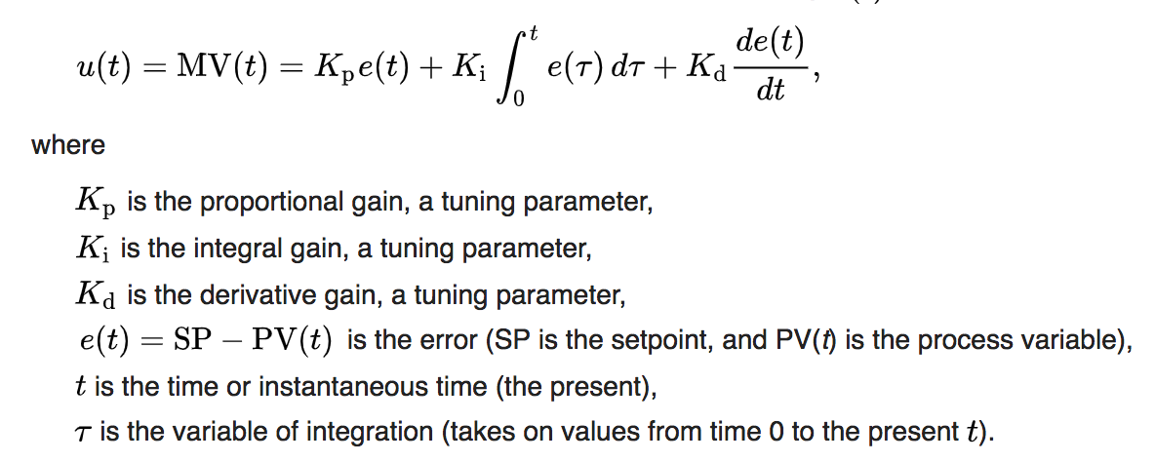
PID

Slide 91
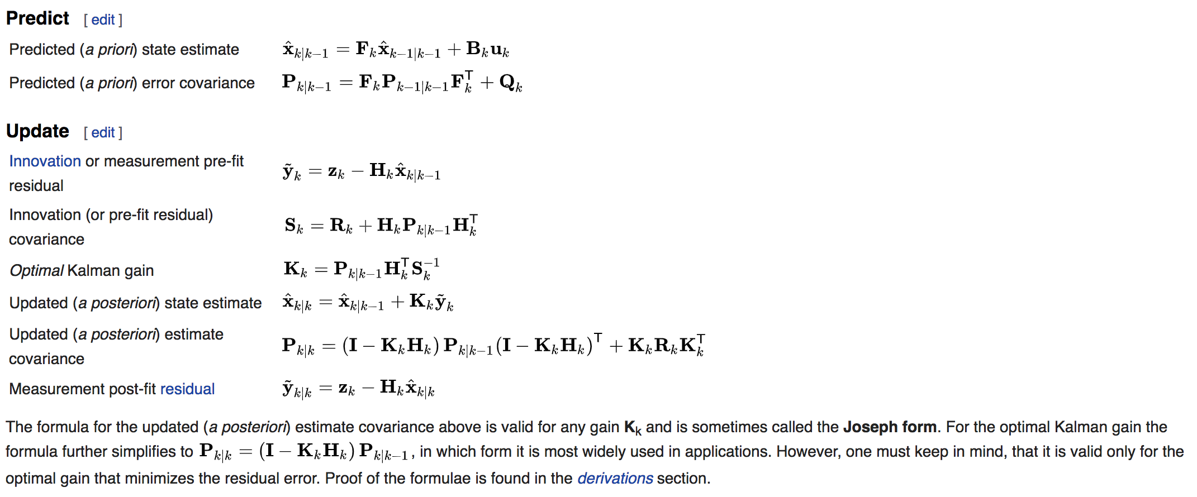
Kalman Filter

Slide 92
Application (orzhttpd)
typedef struct {
time_t now; f039 574e
socklen_t salen; 0010 0000
unsigned int proc_num; 0001 0000
char sysname[SYS_NMLN]; 694c 756e +
const char *configfile; a870 bfb3
CONFIG_t config;
typedef struct {
uint16_t port; 0050 0000
const char *user; 0118 0837
const char *host; 0138 0837
const char *basedir; 0158 0837
const char *vhostbase; 01b0 0837
const char *errmsgpath; 0208 0837
const char *indexfile; 0260 0837
const char *userdir; 0280 0837
const char *accesslog; 02a0 0837
const char *errorlog; 0308 0837
const char *passfile; 0000 0000
unsigned int options; 0036 0000
} CONFIG_t
HTTP_STATE_t (*write)(CONN_t *); ace8 0804
void (*log)(LOG_TYPE_t, const char *); af04 0804
FILE *access_log; 2158 0837
FILE *error_log; 22c8 0837
} SERVER_t;
How can a semantic memory dump data structure layout provided by ReViver assist with detecting a non-control data attack?
08352000 0000 0000 00a9 0000 f039 574e 0010 0000
08352010 0001 0000 694c 756e 0078 0000 0000 0000
08352020 0000 0000 0000 0000 0000 0000 0000 0000
08352030 0000 0000 0000 0000 0000 0000 0000 0000
08352040 0000 0000 0000 0000 0000 0000 0000 0000
08352050 0000 0000 0000 0000 a870 bfb3 0050 0000
08352060 0118 0837 0138 0837 0158 0837 01b0 0837
08352070 0208 0837 0260 0837 0280 0837 02a0 0837
08352080 0308 0837 0000 0000 0036 0000 ace8 0804
08352090 af04 0804 2158 0837 22c8 0837 efef efef
083520a0 fefe fefe 00a0 0000 0000 0000 c409 0001
...
Part of memory snapshot of orzhttpd

Slide 93
Application (orzhttpd)
08370110 0000 0000 0021 0000 7777 2d77 6164 6174
08370120 ef00 efef feef fefe 15fe 0000 0000 0000
08370130 0000 0000 0021 0000 726f 2e7a 7962 6873
08370140 6e65 6e2e 7465 ef00 efef feef fefe 1bfe
08370150 0000 0000 0059 0000 0100 0000 2f65 6f64
08370160 2f70 6c66 776f 7473 7469 6863 612d 7474
08370170 6361 736b 6f2f 7a72 7468 7074 2f64 726f
08370180 687a 7474 6470 722d 6165 2d64 6e6f 796c
08370190 772f 7777 642f 7461 0061 efef efef fefe
083701a0 fefe 004e 0000 0000 0000 0000 0059 0000
083701b0 682f 6d6f 2f65 6f64 2f70 6c66 776f 7473
083701c0 7469 6863 612d 7474 6361 736b 6f2f 7a72
083701d0 7468 7074 2f64 726f 687a 7474 6470 722d
Part of memory snapshot of orzhttpd
The original root directory is “/home/orzhttpd/orzhttpd-read-only/www/data”

Slide 94
Live Memory Data Manipulation Attack
Sensitive data source (e.g., sensors)
Sensitive region locator within the dynamic memory (through memory taint tracking)
Candidate memory addresses
Memory structural pattern extraction
Logical graph-based memory pattern predicates
Controller executable
Instantiated object and member field data type reverse engineering
Extracted code and data pointers and their interdependencies
Binary code generation
Exploit
Memory vulnerability exploit

Slide 95
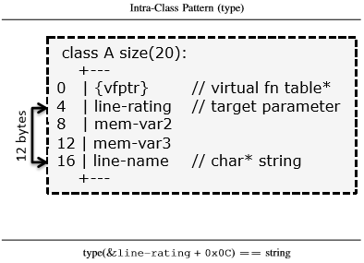
Logical memory structural patterns
Intra-class type patterns
Code pointer-instruction patterns
Data pointer-based patterns
Intra-class
Fixed offset
Data types and/or values

Slide 96
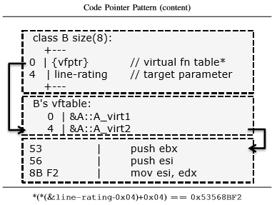
Logical memory structural patterns
Intra-class type patterns
Code pointer-instruction patterns
Data pointer-based patterns
Code segments read-only
Virtual function table
Virtual function prologue

Slide 97
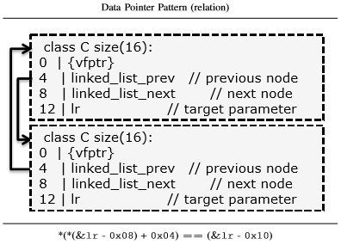
Logical memory structural patterns
Intra-class type patterns
Code pointer-instruction patterns
Data pointer-based patterns
Inter-object dependencies
Recursive pointer traversal
Direct graph

